Slide 1
Amazon Sales Presentation Done by : Salma Mamdoh

Slide 2
Project analysis slide 2
Project Analysis
Data Visualization
Exploratory Data Analysis (EDA)
PROJECT
Predictive Modeling
Data Preprocessing
Model Evaluation
Dashboard

Slide 3
Project analysis slide 3
Project Analysis
Exploratory Data Analysis (EDA):
Data Processing
Data Visualization
Predictive Model
Dashboards
Loaded and inspected dataset structure, identified data types, and generated summary statistics including visualizations for numerical and categorical variables.
.
Developed model using logistic regression to forecast order status, evaluated their performance using metrics like accuracy and recall, and ensured robustness through cross-validation.
Created an interactive dashboard using widgets to present key insights and visualizations from the data analysis, ensuring user-friendly access to actionable business insights.
Handled missing values, converted data types, and treated outliers to prepare for analysis and modeling.
Created visualizations using Matplotlib and Seaborn to explore data distributions, trends over time, and relationships among variables.

Slide 4
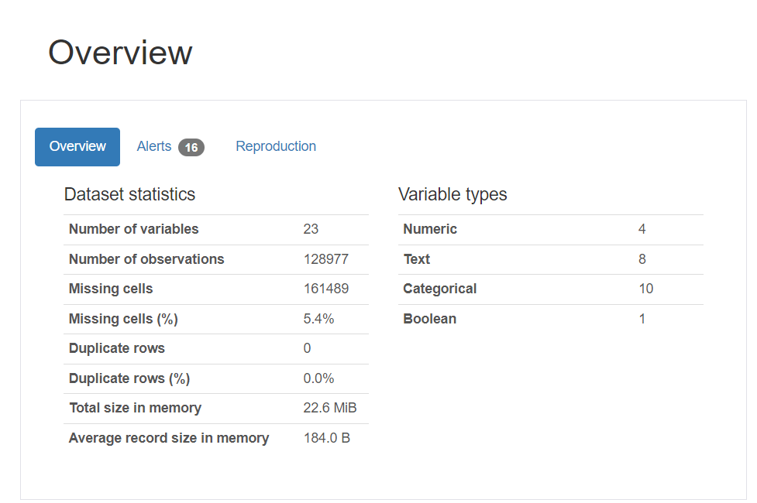
Exploratory Data Analysis (EDA)
1. Data Inspection:
- Loaded the dataset and examined its structure to understand columns and rows.
- Identified data types (numerical, categorical) and potential issues like missing values or inconsistent formats.
2. Summary Statistics:
- Calculated statistics (mean, median, min, max) for numerical variables.
- Visualized distributions of numerical variables using histograms and box plots.
- Analyzed categorical variables through frequency tables and bar plots to identify patterns and trends.

Slide 5
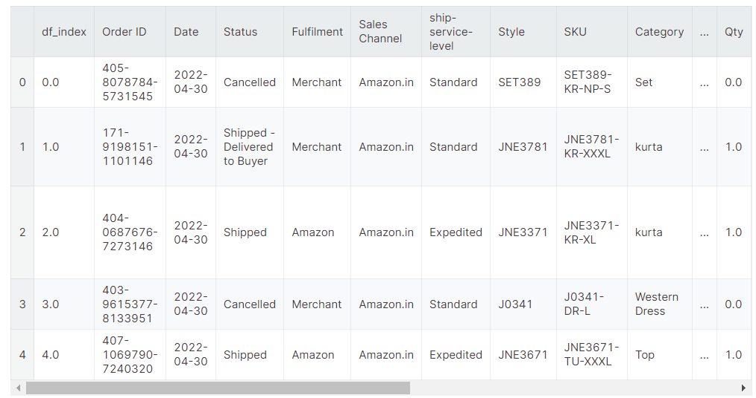
Data Processing
Handling Missing Values:
Strategically managed missing data through imputation or removal to maintain dataset integrity.
Data Type Conversion:
Converted relevant columns (e.g., Date) to appropriate formats (e.g., datetime) for consistency and analysis readiness.
Outlier Detection and Treatment:
Identified and managed outliers in numerical data to enhance data quality and reliability.

Slide 6
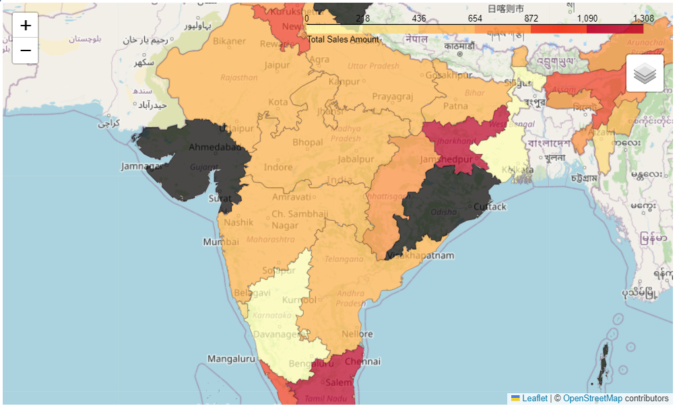
Data Analysis
Sales Trends Over Time:
Analyzed monthly or quarterly sales trends to identify patterns and seasonality.
Top-Selling Products and Categories:
Identified key products and categories driving sales based on volume or revenue.
Regional Sales Distribution:
Visualized geographic sales distribution to highlight regional performance variations.

Slide 7
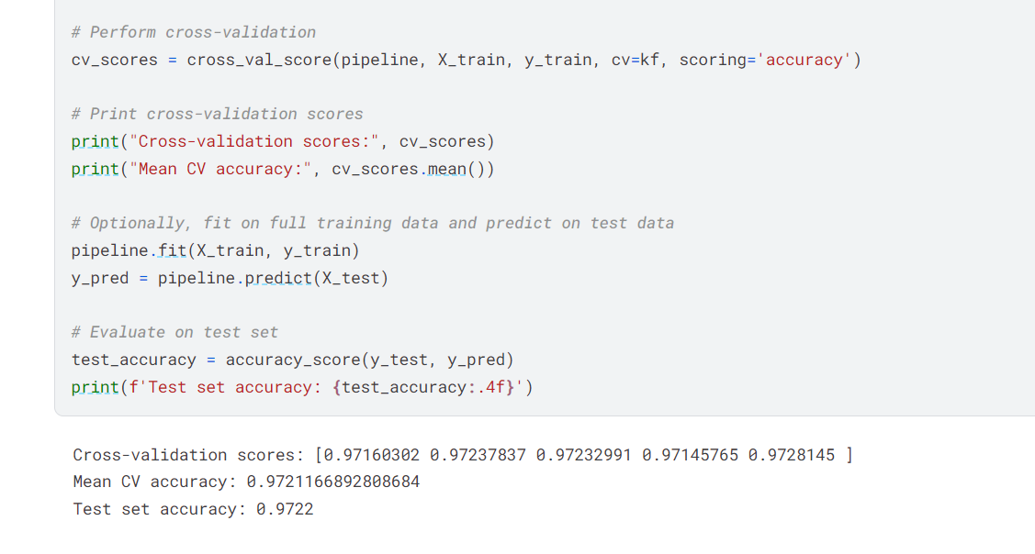
Predictive Model and Evaluation
Building Predictive Models:
Developed classification models using logistic regression to predict order status.
Used algorithms suitable for the dataset and business objectives.
Model Evaluation:
Assessed model performance using metrics such as accuracy, precision, recall, and F1-score.
Conducted cross-validation to ensure robustness and generalizability of models.

Slide 8
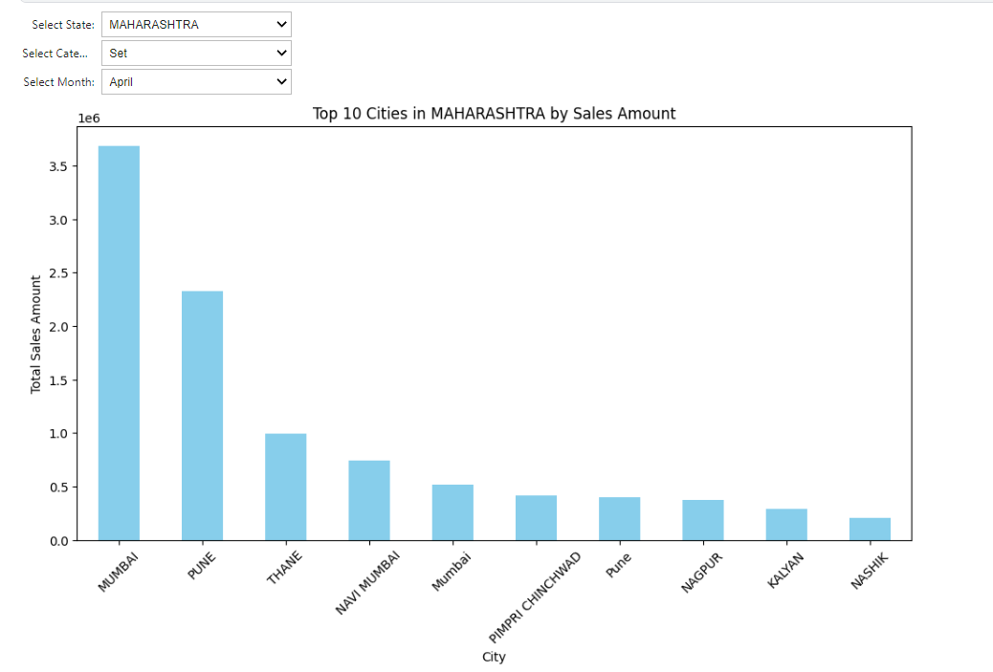
Dashboards
Interactive Dashboard Creation:
Developed an interactive dashboard using Python libraries ipywidgets.
Integrated widgets such as dropdowns, sliders, and buttons for user-friendly exploration of data.
Key Features of the Dashboard:
Implemented interactive elements to facilitate easy data filtering and exploration.
Ensured the dashboard presents actionable insights effectively and intuitively.

Slide 9
Thank You

